Slide 1
Comparative Analysis of Skin Cancer and Skin Lesion Classification: A Performance Evaluation of CNN Image Classifiers
Task 4
Team : 19
Abu Bakar Hasnath (20301037),
Faisal Shahriar (20301020),
Sayad Md. Prio (20101356),
Sulaiman Hossain Tonmoy (20301010)
CSE438: Applied Data Science for practitioners
Instructor: Annajiat Alim Rasel (AAR)
Notes:
K

Slide 2
Outline
Abstract
Introduction
Objective
Literature review
Dataset
Data Preprocessing
Methodology
Result analysis
Limitations

Slide 3
Abstract
Abnormal growth of skin cells, commonly known as skin cancer, can form life-threatening diseases if not treated timely. This necessitates proper identification and immediate treatment of skin cancer. Recently, there has been a notable advancement in using machine learning methods to analyze medical images. There is a huge potential in machine learning methods for automatically detecting and categorizing skin cancer. This paper explores a comprehensive technique using machine learning tools for detecting and categorizing skin cancers. For this project, we have used the HAM10000 dataset which consists of 10000 medical images of skin cancer varying in types and patient demographics. Our project analyzes the efficiency of InceptionV3, ResNet50, VGG16. Rigorous assessment methods like Accuracy, precision, Recall rate, and F1-score are used to measure the effectiveness of these algorithms. Overall model performance was strong with Inceptionv3 acquiring the highest accuracy of 83.63%, while InceptionResNetv2 gave an accuracy of 82.70%. Our presented approach makes a significant contribution to advancing dermatology by creating advanced diagnostic tools that will be crucial for healthcare professionals and also beneficial for patients affected by skin cancer. Our investigation shows the potential of Machine learning methods to enrich health outcomes by enhancing automated early detection processes enabling us with personalized treatments tailored to effectively address skin cancer.

Slide 4
Introduction: Defining the problem statement
The most prevalent type of cancer, skin cancer, is caused by uncontrollably growing skin cells. The main cause of skin cancer are overexposure to ultraviolet(UV) light from the sun or any artificial source.
The deadly complications from skin cancer can be decreased by adequate treatment following early diagnosis.
Recent progress in machine learning, especially in medical image analysis, has shown promise in automating skin lesion detection and categorization.
Early and precise identification of skin cancer is critical for timely diagnosis and treatment, preventing disease progression and improving patient outcomes.
Leveraging machine learning techniques can lead to the development of precise diagnostic tools beneficial for both healthcare professionals and patients.

Slide 5
Objective
To explore a comprehensive technique using machine learning tools for detection and categorize skin cancers
Utilized the HAM10000 dataset, comprising 10,000 medical images of skin cancer with variations in types and patient demographics.
Evaluate the efficiency of the following CNN classifiers: InceptionResNetv2, InceptionV3, ResNet50 and VGG16
So that machine learning application can be readily deployed on the medical field

Slide 6
Literature review
In this research paper, Hossian et al[1]. combined three different CNN techniques. In this way, the authors of the paper were able to identify a normal kidney image or include a cyst, stone or tumor. The authors divided the images into sections according to the impacted region with the help of a watershed algorithm. Models like EANet, ResNet50, and a modified convolutional neural network were employed.
In this research paper Sea-Lim et al[5]. presented a unique approach to classify skin lesions. Here the authors used a lightweight Convolutional Neural Network (CNN) called MobileNet. Furthermore, the authors utilized two iterations of mobileNet one original and the other one modified version to investigate the dermatoscopic image data from the HAM 10000 dataset.
Noor et al[3]. utilized Support Vector Machines (SVM) for skin cancer classification.Several machine learning techniques, including CNNs, ANNs, inception V3s, and many more, have been employed for the classification of malignancies and the diagnosis of melanoma.To characterize images, support vector machines (SVMs) have been employed. Using an ANN method, this research article achieved 96% sensitivity and 93% specificity.

Slide 7
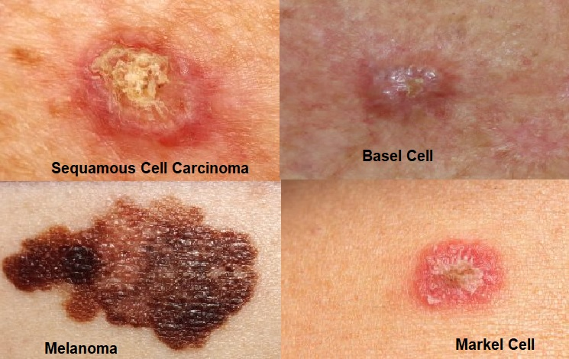
Dataset
Hybrid dataset
Collected from kaggle
Skin cancer
Consists of 20k and 20.6K respectively
Contains 10,000 images
Contain 7 classes
(Actinic keratosis, Basal cell carcinoma, benign lesion, dermatofibroma, melocytic, myeloma and vascular lesion)

Slide 8
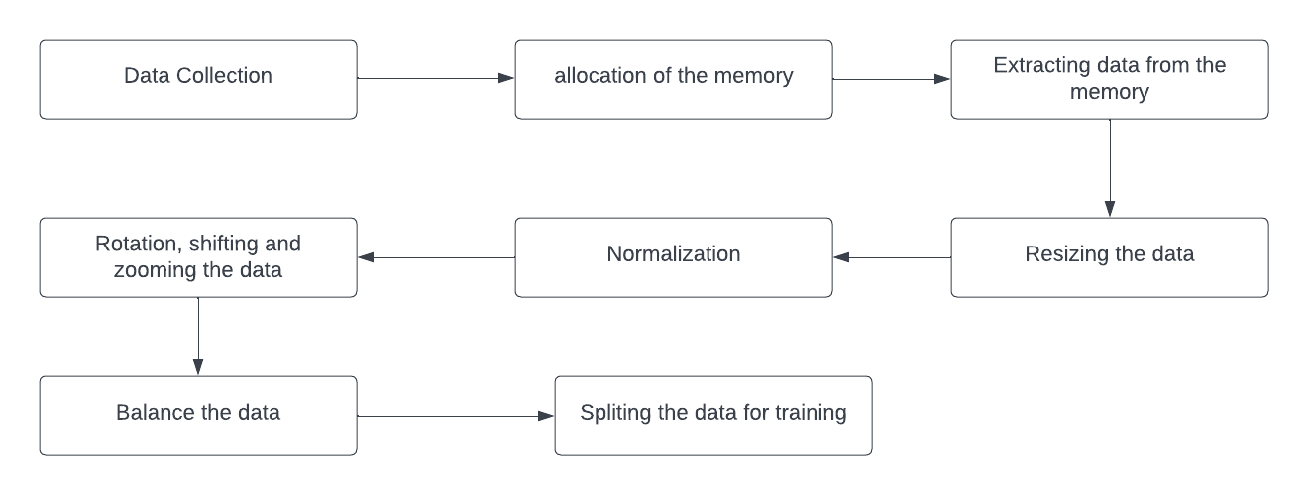
Data Preprocessing
Data preprocessing

Slide 9
Methodology
InceptionResNetV2:
deep convolutional neural network architecture
developed by Google's research architecture team
kernel size (1*1), (3*3), and (5*5)
residual connection intercorporate
Notes:
Healthcare Data Challenge: Healthcare faces challenges in accessing diverse datasets, as medical data is distributed across many institutions globally.
Legal and Regulatory Barriers: Centralized data aggregation for AI training in healthcare is increasingly restricted due to legal and regulatory barriers protecting data privacy.

Slide 10
Methodology
InceptionV3:
Evolved from InceptionResNet V2
capture features at different scales
inception modules are the key component
Auxiliary classifiers are also added to mitigate the layers

Slide 11
Methodology
ResNet50:
deep convolutional neural network architecture
developed by the Microsoft Research team
bottleneck architecture is used
balance of depth and computing efficiency

Slide 12
Methodology
VGG16:
convolutional neural network architecture
developed by Visual Graphic Group (VGG) at University of Oxford
multiple convolutional layers with 3*3 filters
Max pooling layers preserve the most significant features

Slide 13
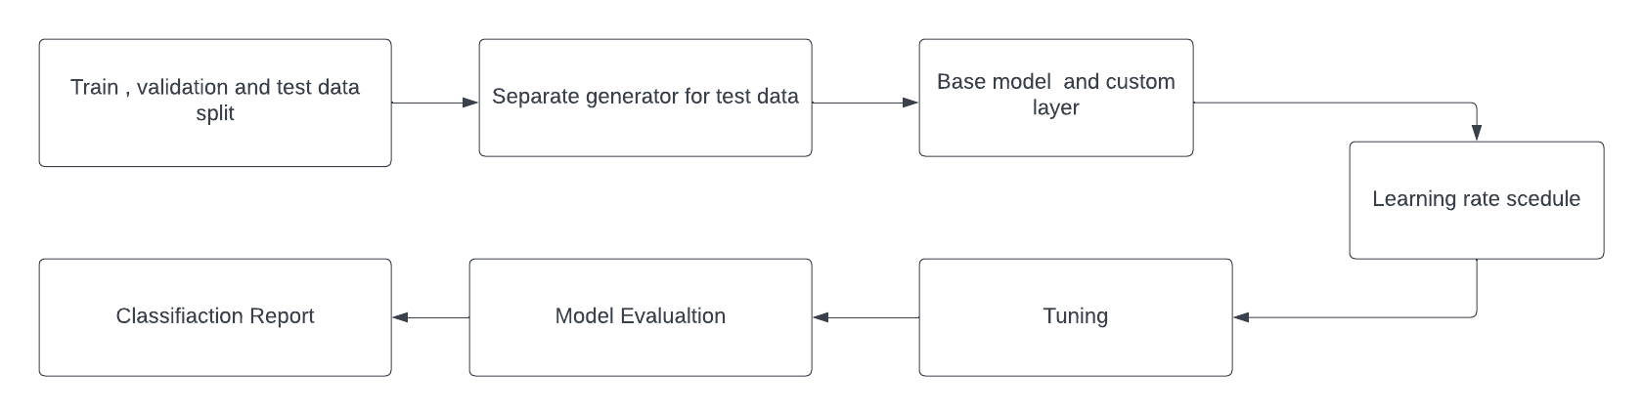
Methodology

Slide 14
Result Analysis
InceptionResNetV2 | 82.70%
InceptionV3 | 83.63%
ResNet50: | 76.43%
VGG16: | 66.95%

Slide 15
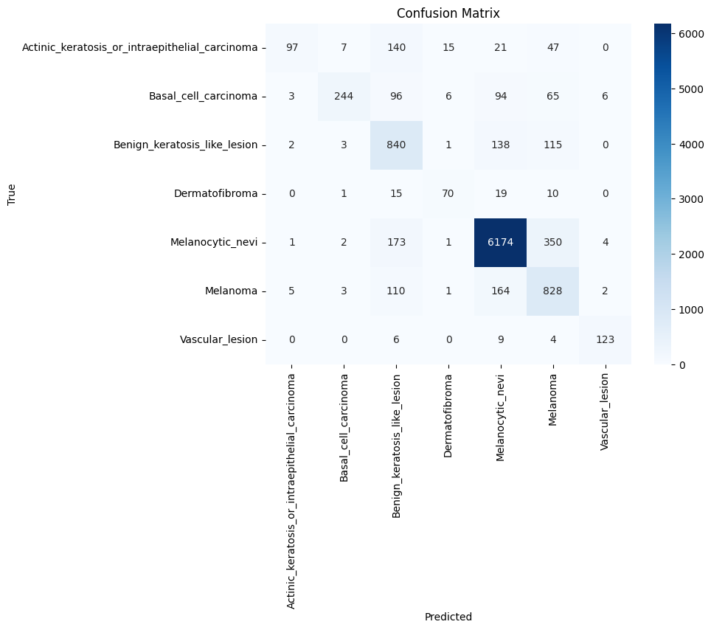
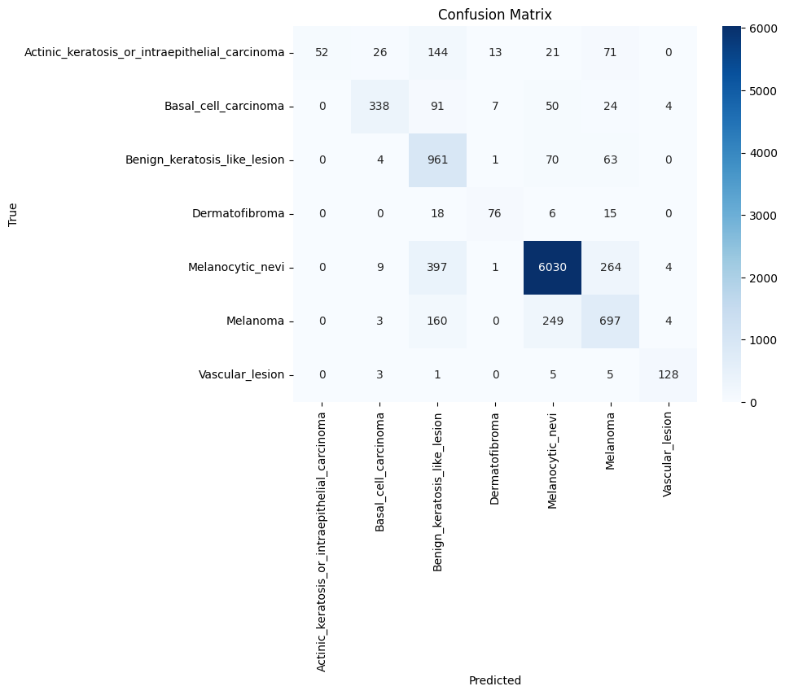
Result Analysis
Inceptionv3
InceptionResNetV2

Slide 16
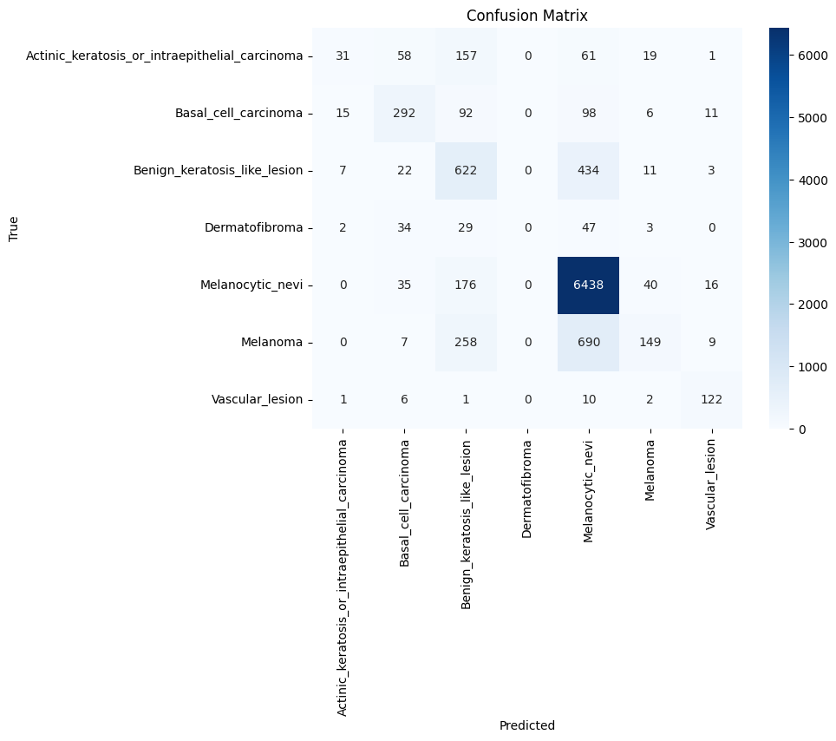
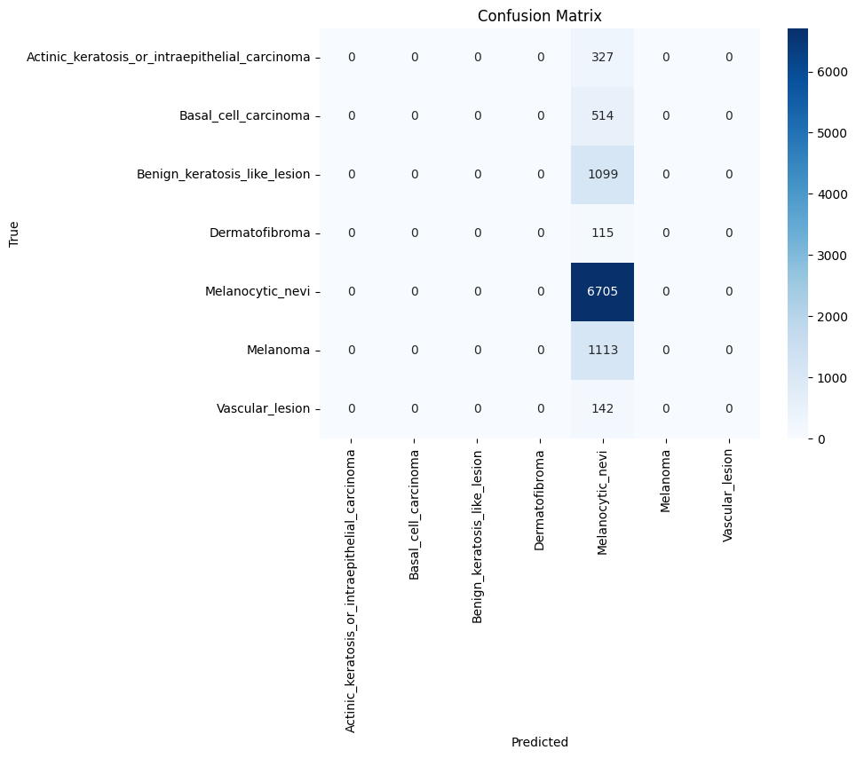
Result Analysis
VGG16
ResNet50

Slide 17
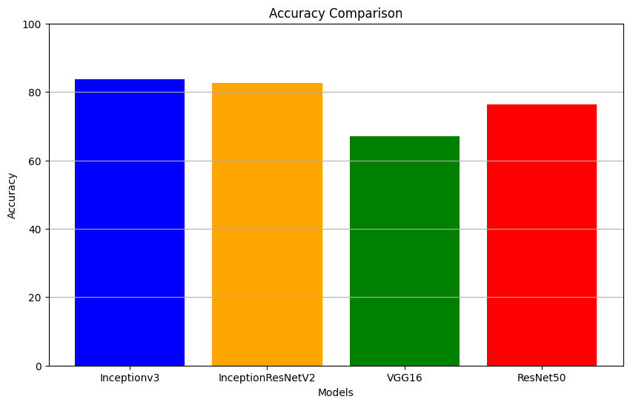
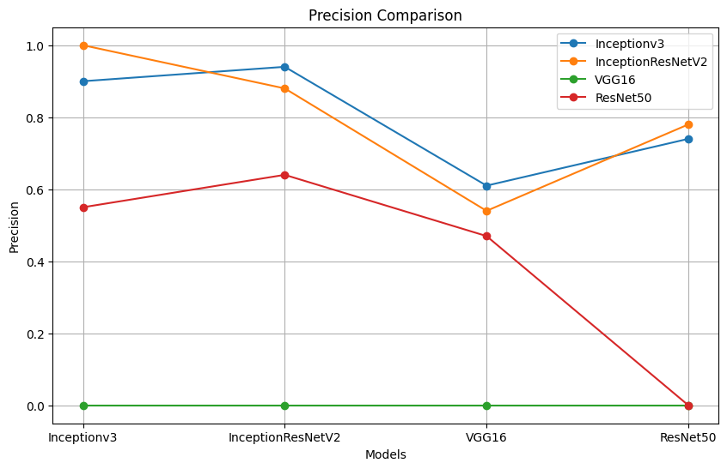
Result Analysis
Inceptionv3 achieved the highest accuracy among the models evaluated, with an accuracy of 83.63%.
InceptionResNetV2 closely followed Inceptionv3 with an accuracy of 82.70%.
ResNet50 showed a reasonable performance with an accuracy of 76.43%.
VGG16 had the lowest accuracy among the models, with an accuracy of 66.95%.
In terms of precision, recall, and F1-score, Inceptionv3 consistently outperformed the other models across all classes.
While VGG16 had the lowest accuracy, it also had the lowest precision, recall, and F1-score across all classes.
ResNet50 showed competitive performance but was outperformed by both Inceptionv3 and InceptionResNetV2 in terms of accuracy and precision.
Overall, Inceptionv3 and InceptionResNetV2 demonstrated superior performance compared to VGG16 and ResNet50 in classifying skin lesions.

Slide 18
Limitations
Requirement of the data
Computational resource
Robustness to noise inputs
Lack of Interpretability

Slide 19
Reference
[1] M. S. Hossain, S. N. Hassan, M. Al-Amin, M. N. Rahaman, R. Hossain, and M. I. Hossain. (2023). Kidney disease detection from ct images using a customized cnn model and deep learning.
[2] Chang Jie, Chen Jiming, Shao Ying. (2023). A pyramid GNN model for CXR-based COVID-19 classification.
[3]N. ul Huda, R. Amin, S. I. Gillani, M. Hussain, A. Ahmed, and H. Aldabbas. (2023) Skin cancer malignancy classification and segmentation using machine learning algorithms. Available: https://www.sciencedirect.com/science/article/pii/S2772375523000084
[4]L. Tiwari, V. Awasthi, R. K. Patra, R. Miri, H. Raja, and N. Bhaskar, “Lung cancer detection using deep convolutional neural networks,” in Data Engineering and Intelligent Computing: Proceedings of 5th ICICC 2021, Volume 1. Springer, 2022, pp. 373–385.
[5]W. Sae-Lim, W. Wettayaprasit, and P. Aiyarak, “Convolutional neural networks using mobilenet for skin lesion classification,” in 2019 16th international joint conference on computer science and software engineering (JCSSE). IEEE, 2019, pp. 242–24

Slide 20
[6]A. Esteva, B. Kuprel, R. A. Novoa, J. Ko, S. M. Swetter, H. M. Blau, and S. Thrun, “Dermatologist-level classification of skin cancer with deep neural networks,” nature, vol. 542, no. 7639, pp. 115–118, 2017.
[7] Joshi, S. K. (2022). Comparison and Performance Evaluation Using Convolution Neural Network-Based Deep Learning Models for Skin Cancer Image Classification. In Advances in Deep Learning for Medical Image Analysis (pp. 53-68). CRC Press.

Slide 21
Thank you for listening

